Slide 1

FC6W51NT WORK RELATED LEARNING
Presentation

Slide 2
Introduction
University Id: 18030995
Name: Girija Tamang
Course: FC6W51NT – WORK RELATED LEARNING
Academic supervisor: Mr. Pradhumna Dhungana
I worked as an intern in web development at Cubical
Technologies for three months beginning December 5,
2020, to fulfill a portion of the WRL module.

Slide 3
Work Summary
Position in the company The project manager appointed me as an intern in Web Development at the company.
01
Major Responsibility
I used to design and develop different websites and looked after various frontend development of web projects.
02
Working under Project Manager's direction Providing regular updates to the supervisor on the status of ongoing projects and Taking part in stand-up meetings.
03

Slide 4
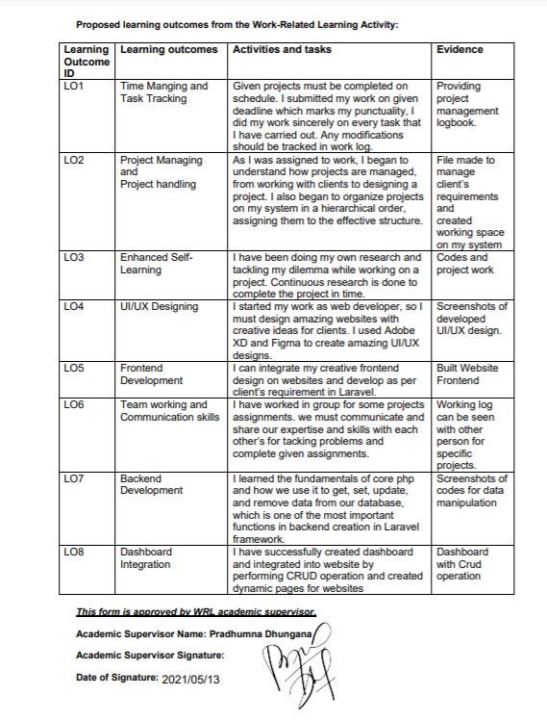
Agreed Learning Outcomes

Slide 5
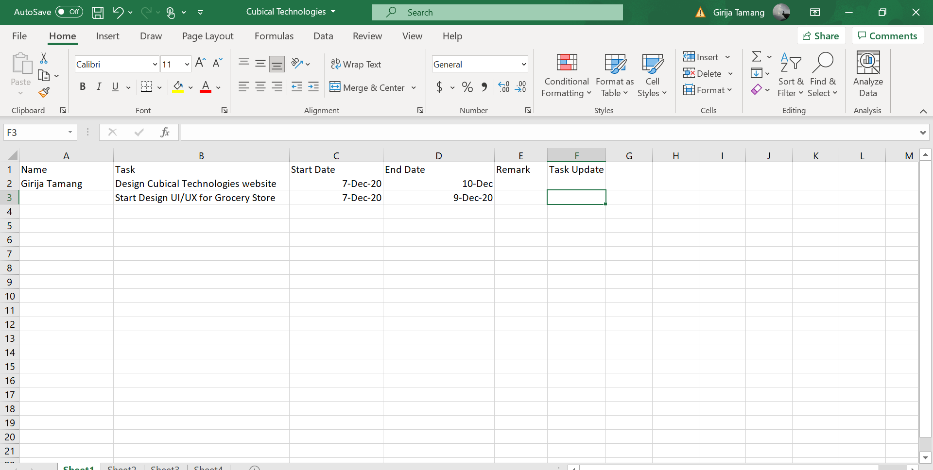
Tasks carried out to achieve LO1
LO1- Time Managing and Task Tracking
Keeping the track of tasks and time allocation during a project.
1 Reviewing the completed tasks with the supervisor before the due date.
2. Prioritizing the tasks wisely and performing the tasks in accordance.
3. Maintaining proper time management and task management logs in Excel Sheet

Slide 6
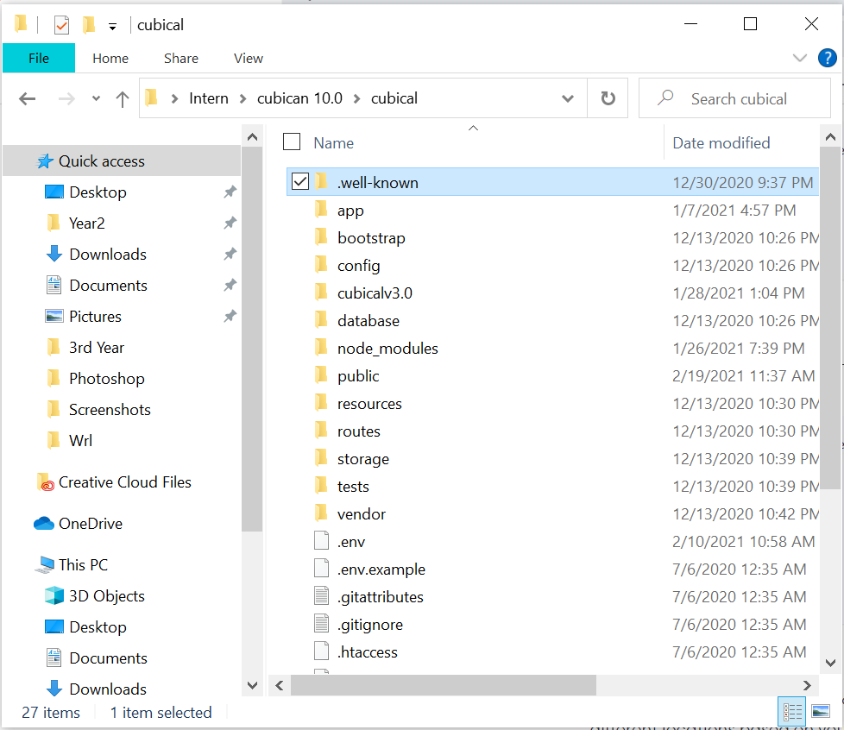
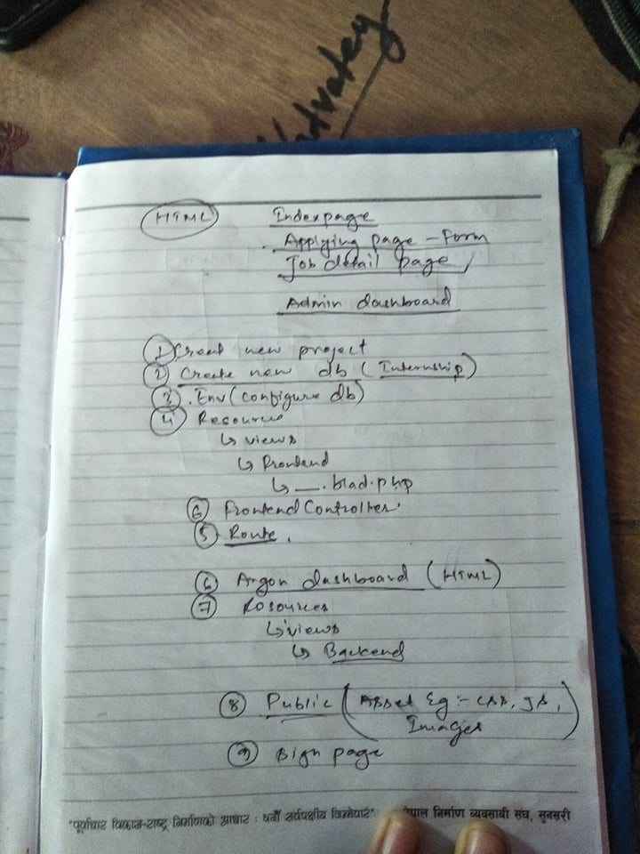
Tasks carried out to achieve LO2
LO2- Project Managing and Project handling
how projects are managed, from working with clients to designing a project.
Began to organize projects on my system in a hierarchical order, assigning them to the effective structure.
Collecting the required resources and information about the project.
Developing project according the wants of clients.

Slide 7
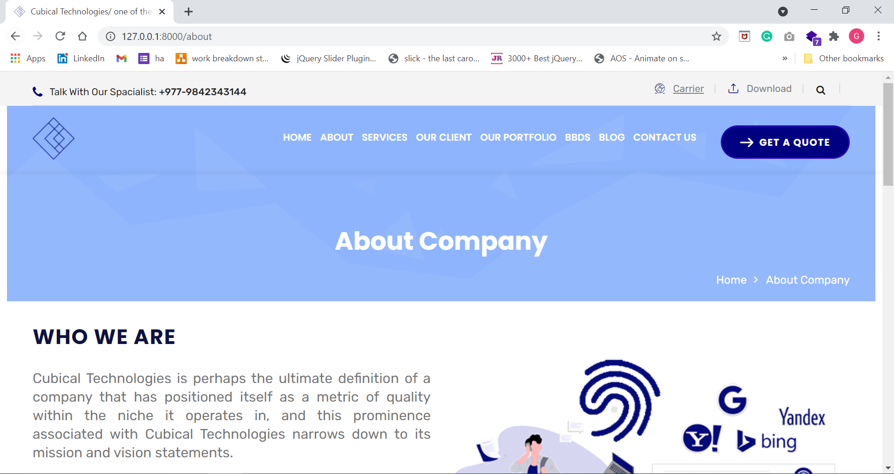
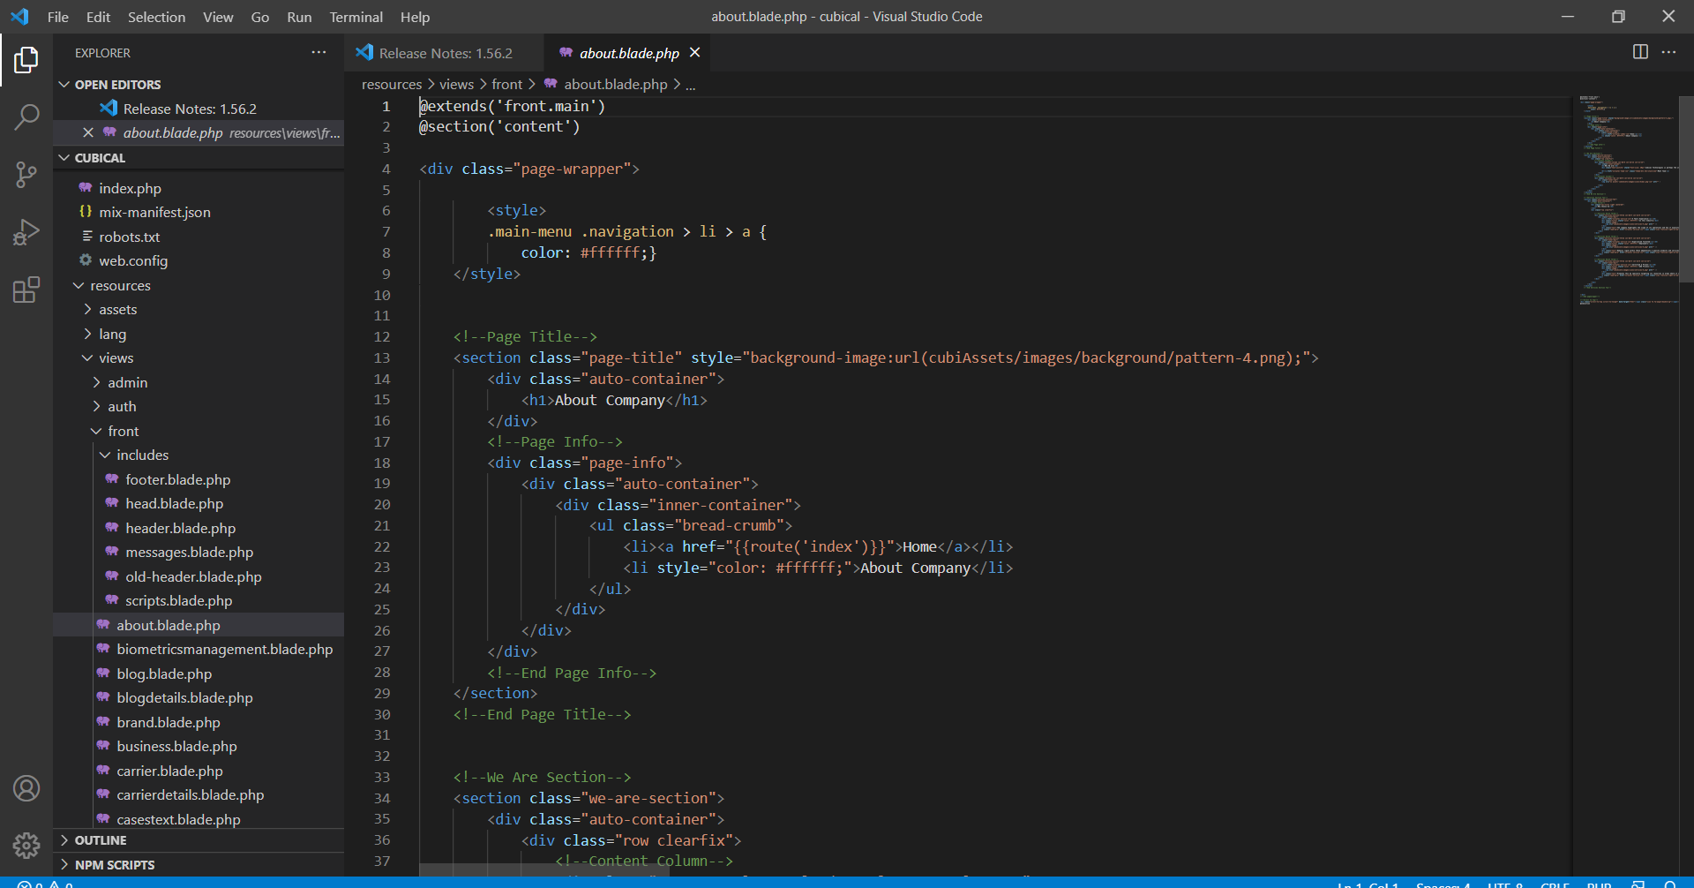
Tasks carried out to achieve LO3
LO3- Enhanced Self Learning
Doing my own research and tackling my dilemma while working on a project.
1. Visiting different websites and analyzing contents by taking help of the supervisor.
2. Not all tasks assigned to me were familiar. At that
time the research and analytical skill used to play a major role.
3. Doing research on various topic to solve the problems while developing projects.

Slide 8
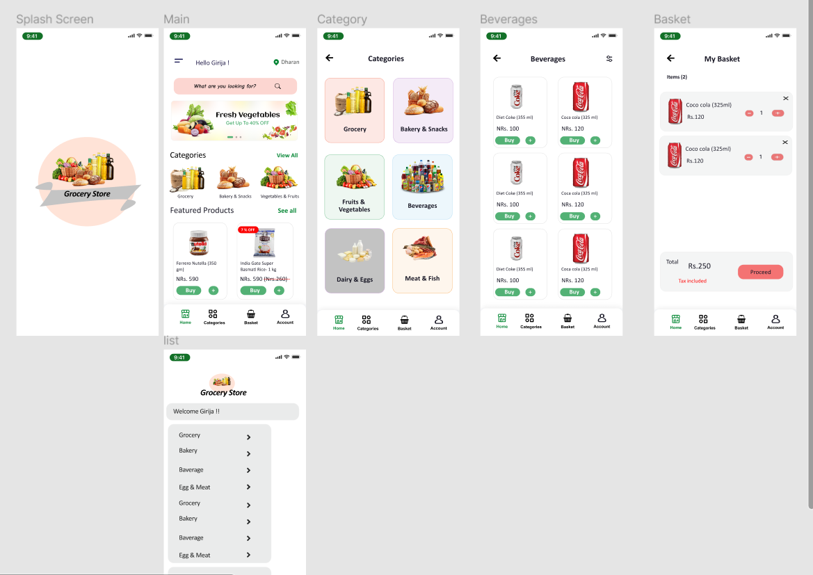
Tasks carried out to achieve LO4
LO4 - UI/UX Designing
I used Adobe XD and Figma to create amazing UI/UX designs.
1. Do research on design.
2. Watching YouTube tutorials.
3. Changing the design idea according to client's feedback.
4. Try to make professional and unique design.

Slide 9
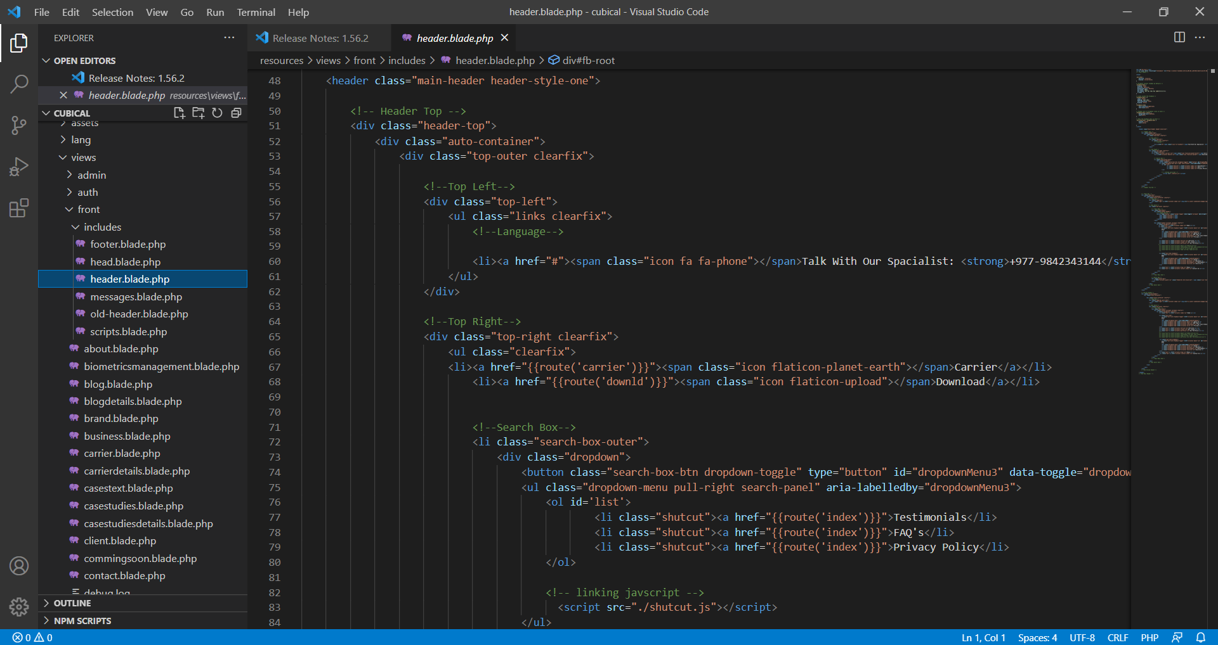
Tasks carried out to achieve LO5
LO5 - Frontend Development
Integrate my creative frontend design on websites and develop as per client’s requirement in Laravel.
First develop the design.
Create project on Laravel.
Start developing the design using HTML, CSS,
JavaScript and Bootstrap.
4. Do testing and fix errors.

Slide 10
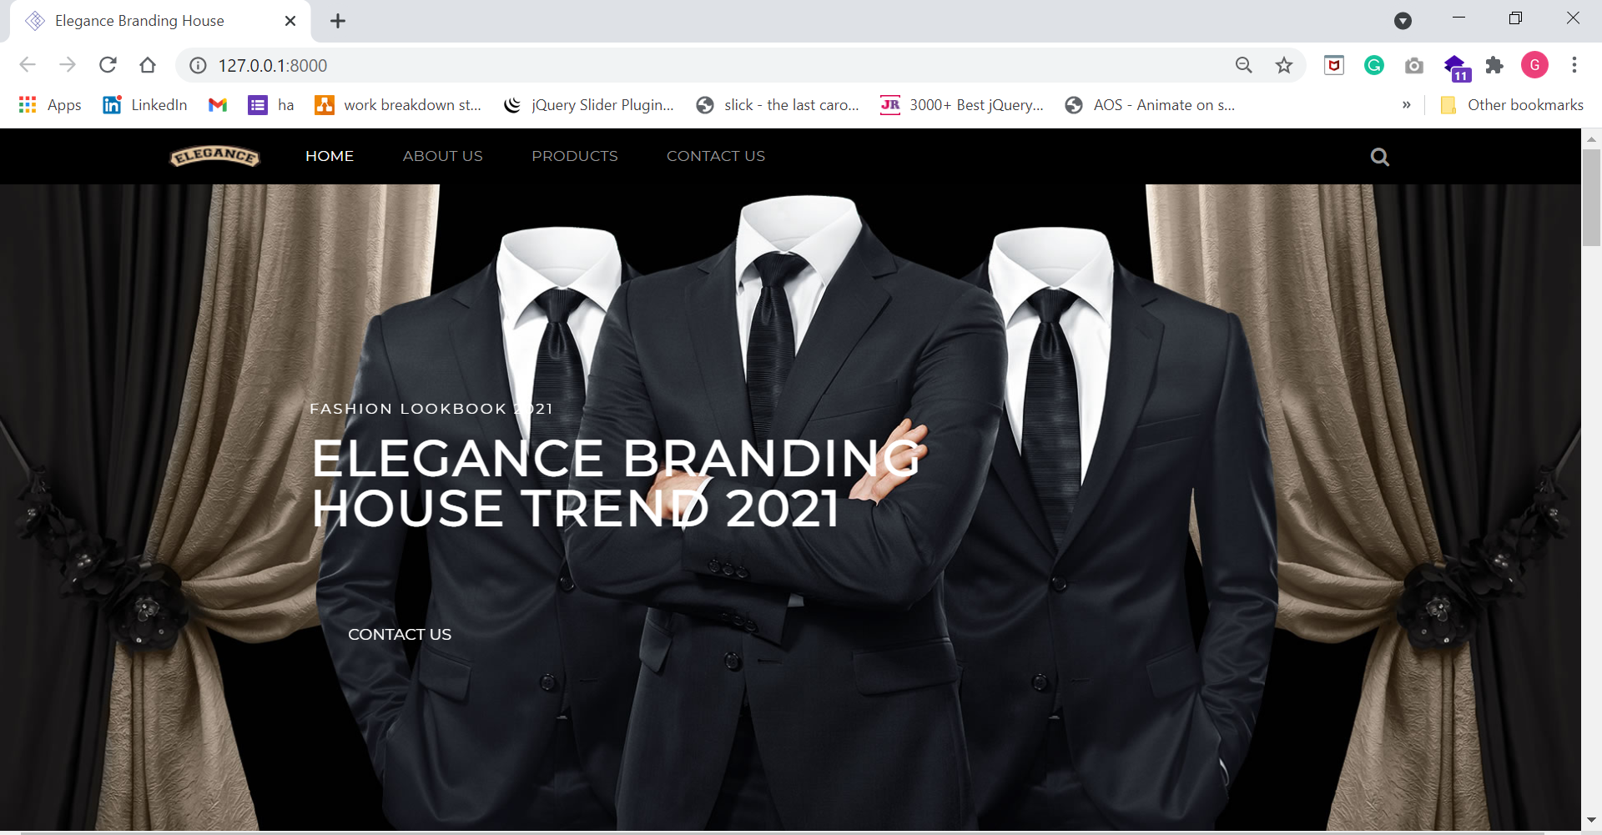
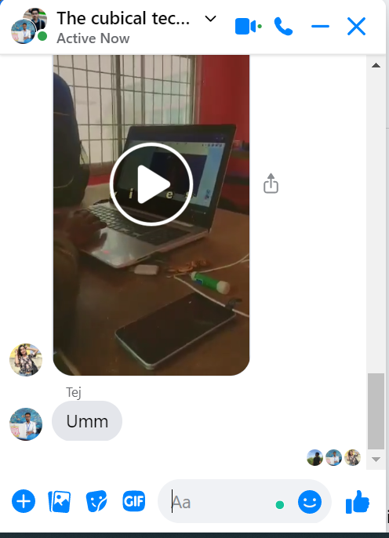
Tasks carried out to achieve LO6
LO6 - Team working and Communication skills
Working on the same project with different people to develop a web application
1. assigned a teamwork with three other interns working in the same company to develop a web application.
2.Divide the task for each member.
3. Develop the project as per the requirements
4.All the modules were merged together, and final web application is created.
5. Do Testing.

Slide 11
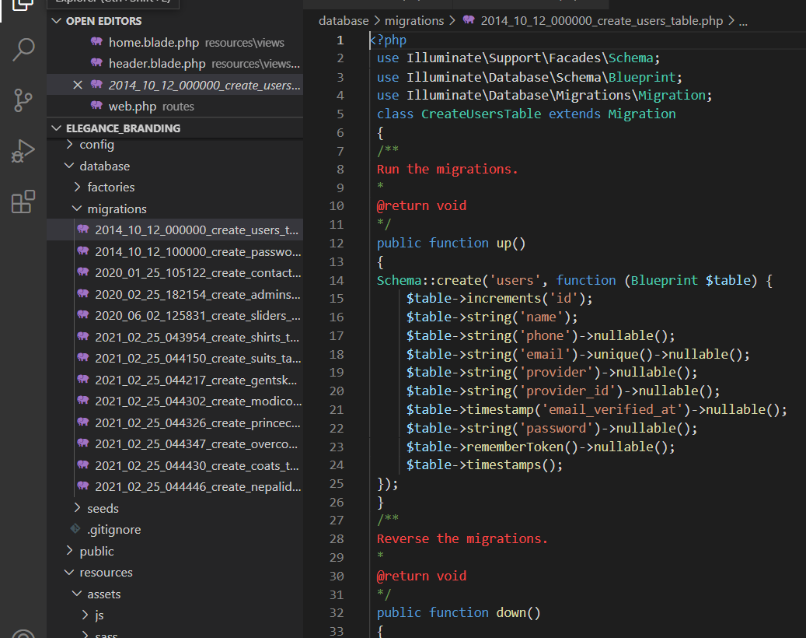
Tasks carried out to achieve LO7
LO7 - Backend Development
learned the fundamentals of core php and how we use it to get, set, update, and remove data from our database
First, a database was created using MYSQL with an entity to store the details of entries.
Different database tables were created to complete and store information successfully.
Since PHP and MYSQL were configured properly, the entries made in the application effectively manipulated the database.
Developing a web application that can perform CRUD operation.
Do testing and reviewed the task with my supervisor.

Slide 12

Problems encountered
Time management
Owing to a lack of personal relationships and presentation skills, I have had difficulty presenting my ideas to my team.
As an extrovert, working with a new department was difficult for me, and I struggled to develop a sense of communication and cooperation in order to collaborate and clear my doubts with the senior.
Using the Laravel framework to create a web application. I had a lot of trouble using this framework because I was unfamiliar with it.
As a beginner web designer, I made a lot of mistake and developed unprofessional design.

Slide 13
Things that I Enjoyed
I had a great time meeting new people with common interests.
Enjoyed the culinary experience at the workplace
Working on the same tasks as a group of other interns.
After becoming acquainted with the office staff, I began to appreciate the office atmosphere and looked forward to going to work on a daily and timely basis.
I had a great time solving various problems.

Slide 14

Future Career Plan
Study Master and Start Freelancing at the same time
After studies, I will be applying in different companies as a front-end developer
Building career as a senior frontend web developer.

Slide 15
Thank You !!

